Slide 1
Florida Department of Transportation
Outdoor Advertising

Slide 2
WHAT IS THE RIGHT OF WAY AND HOW DO I KNOW WHERE IT IS?
The right of way for a road or other transportation facility is the paved area of the road, the road shoulders, sidewalks, swales, and all the other property adjacent to the road owned by the government for the construction and operation of the road or other facility. It may extend far beyond the paved road surface and may or may not be mowed or fenced.

Slide 3
Unauthorized use of the public right of way is prohibited by Florida law.
Illegal use of the right of way is a crime. Each day a violation continues is a separate offense.
Section 337.406, Florida Statutes

Slide 4
Red Arrow = Bad
Green Arrow indicates = Good

Slide 5
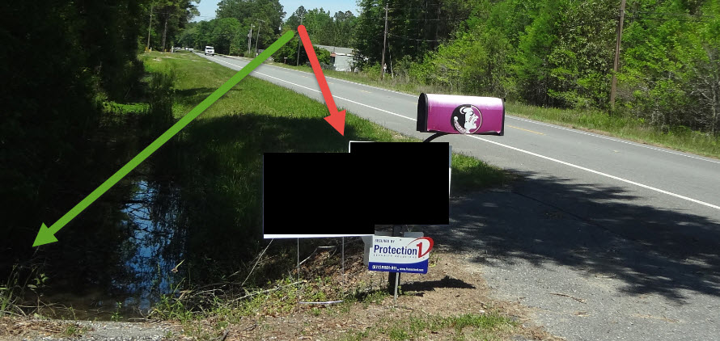

Slide 6
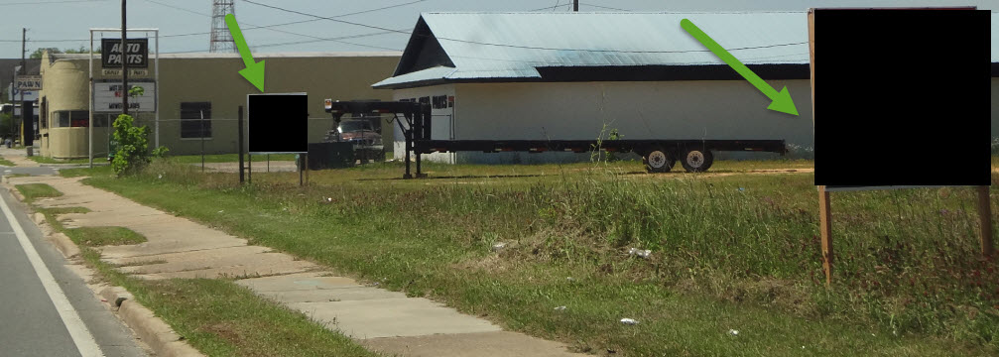

Slide 7
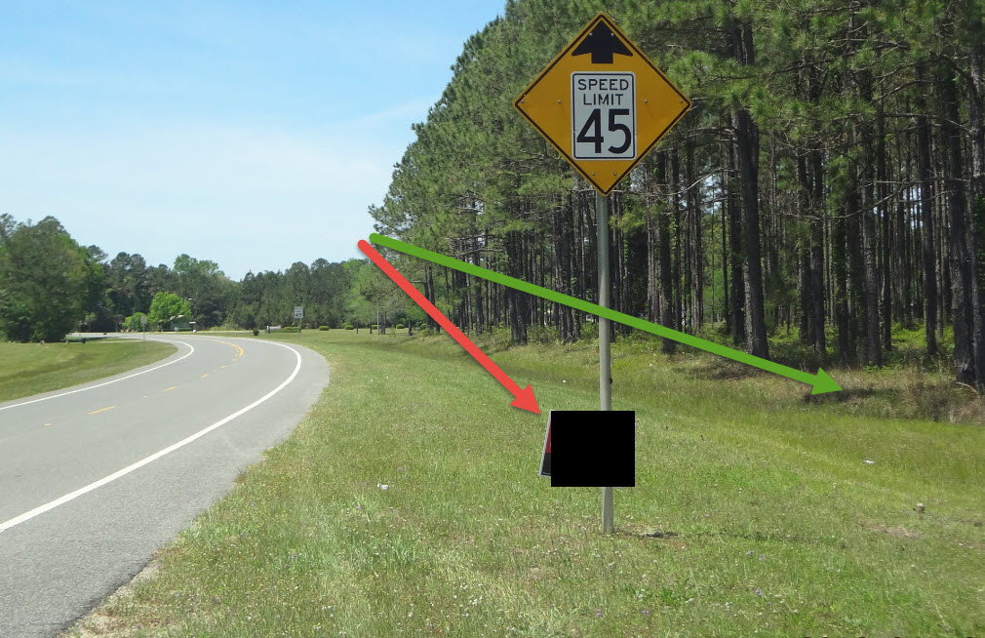

Slide 8
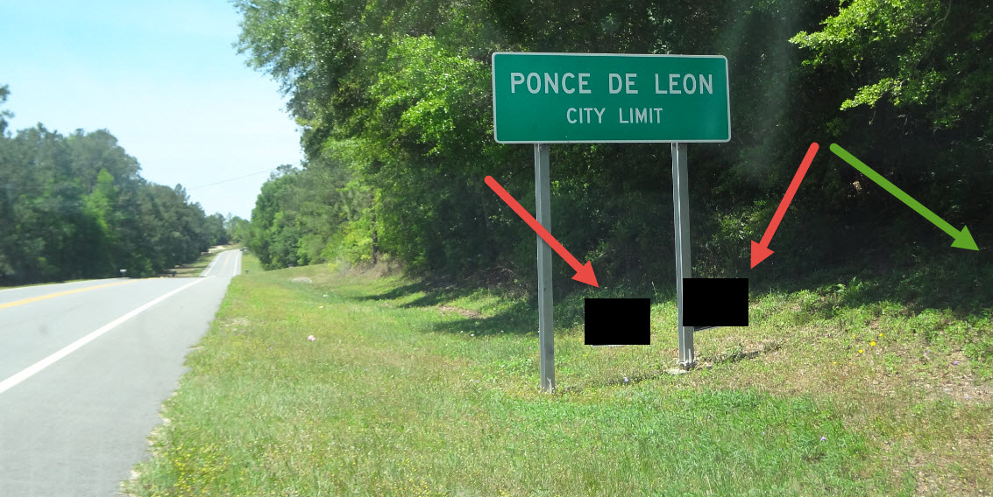

Slide 9
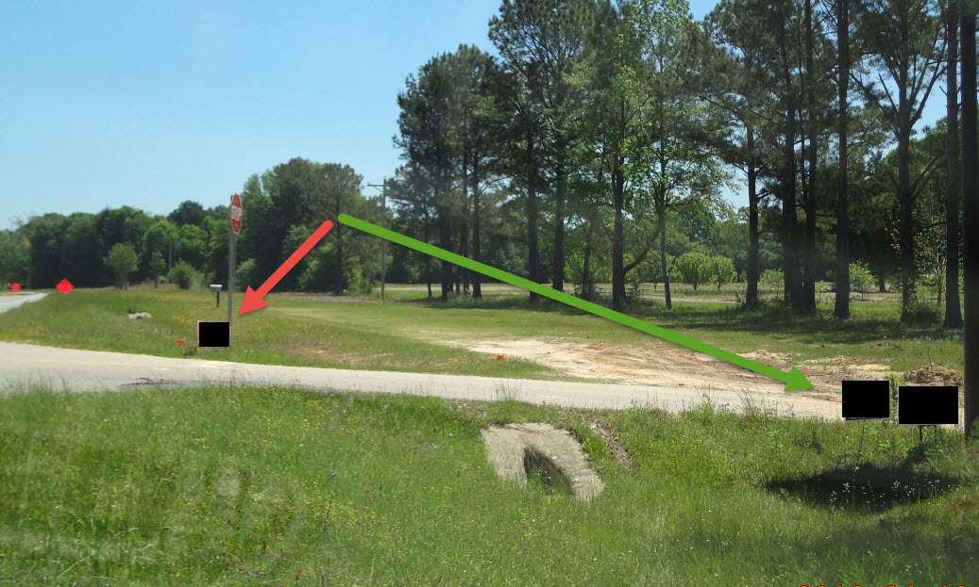

Slide 10
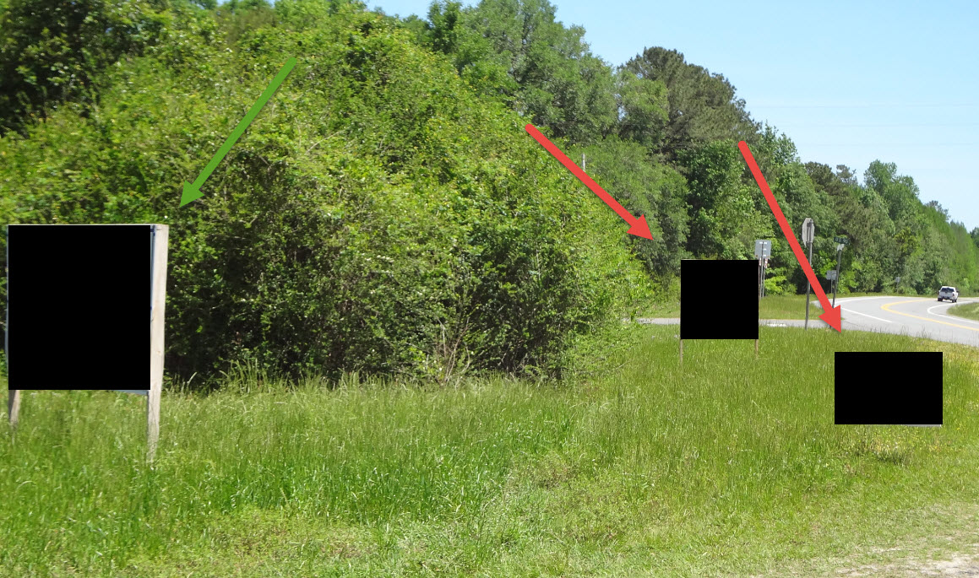

Slide 11
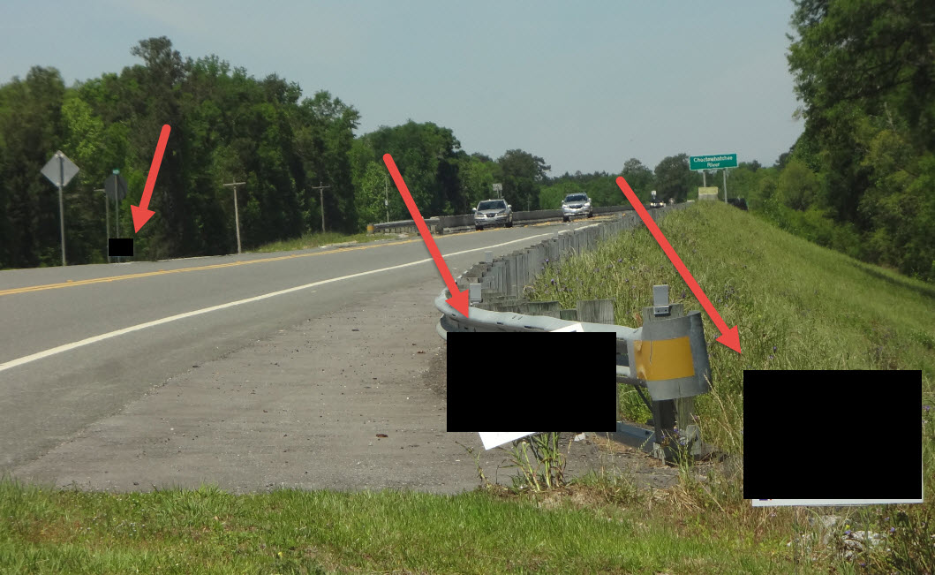

Slide 12
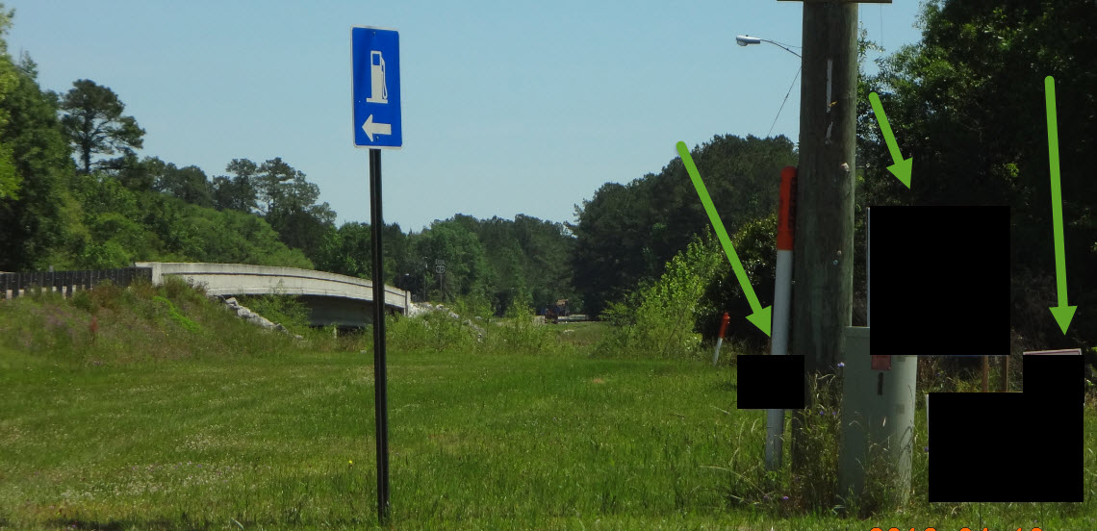

Slide 13
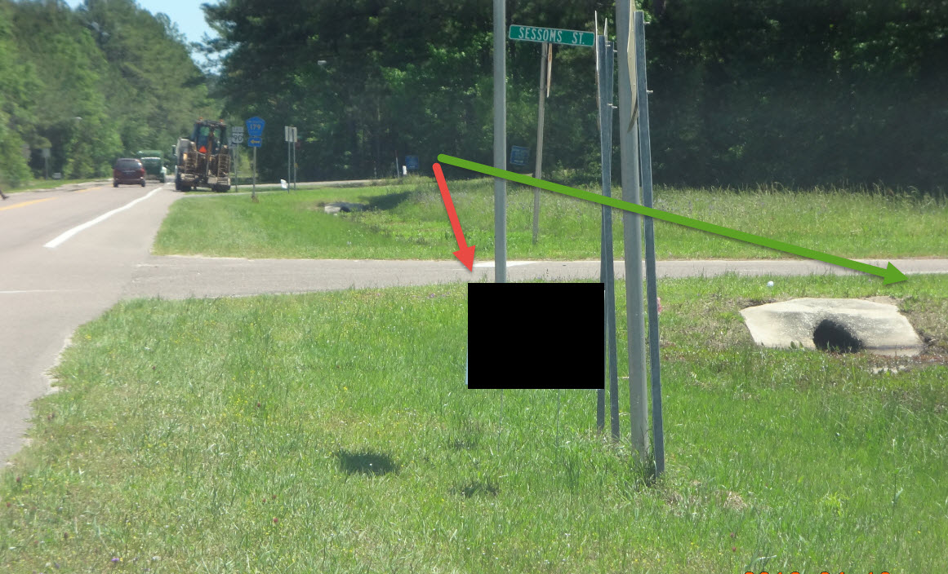

Slide 14
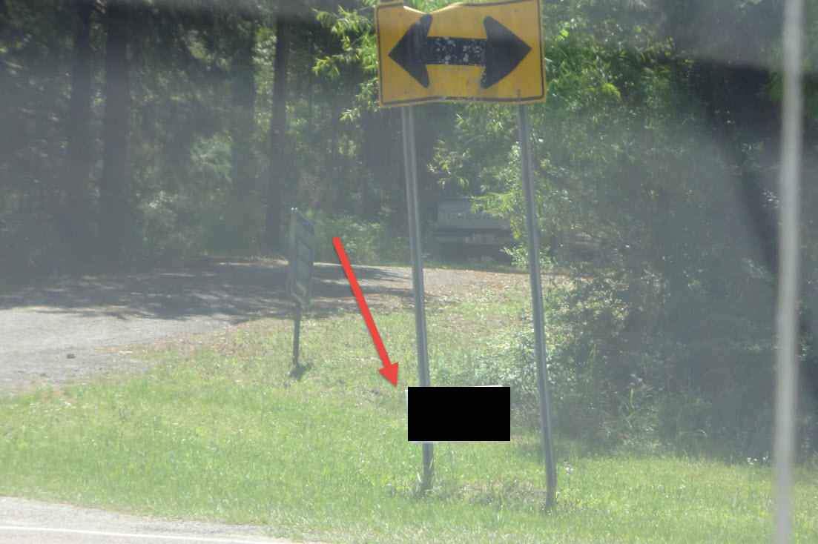

Slide 15
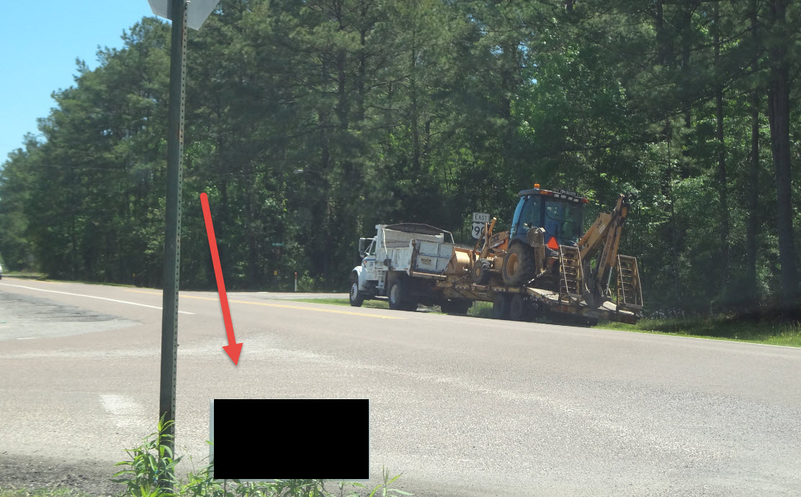

Slide 16
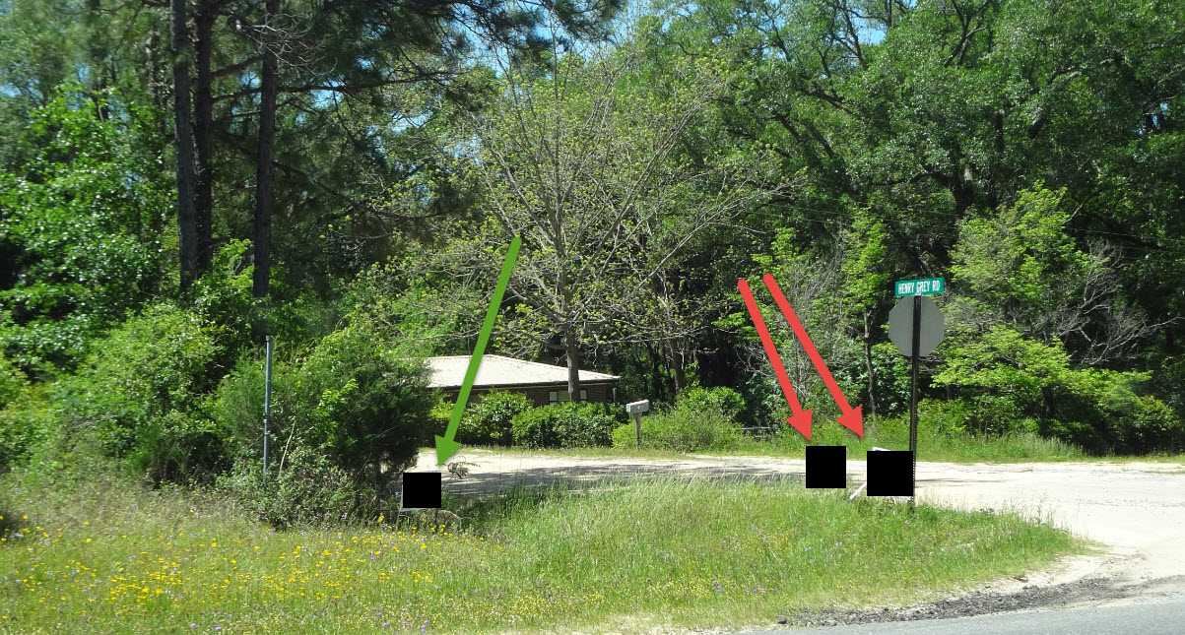

Slide 17
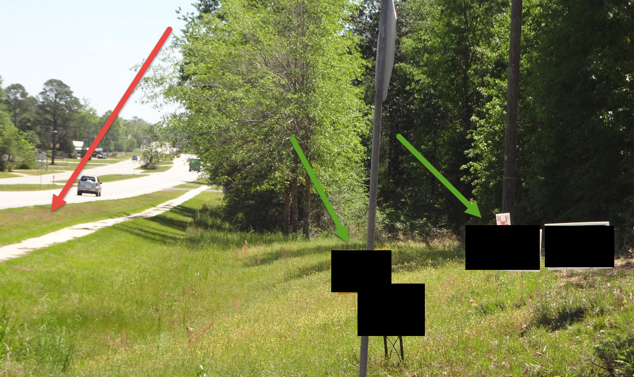

Slide 18
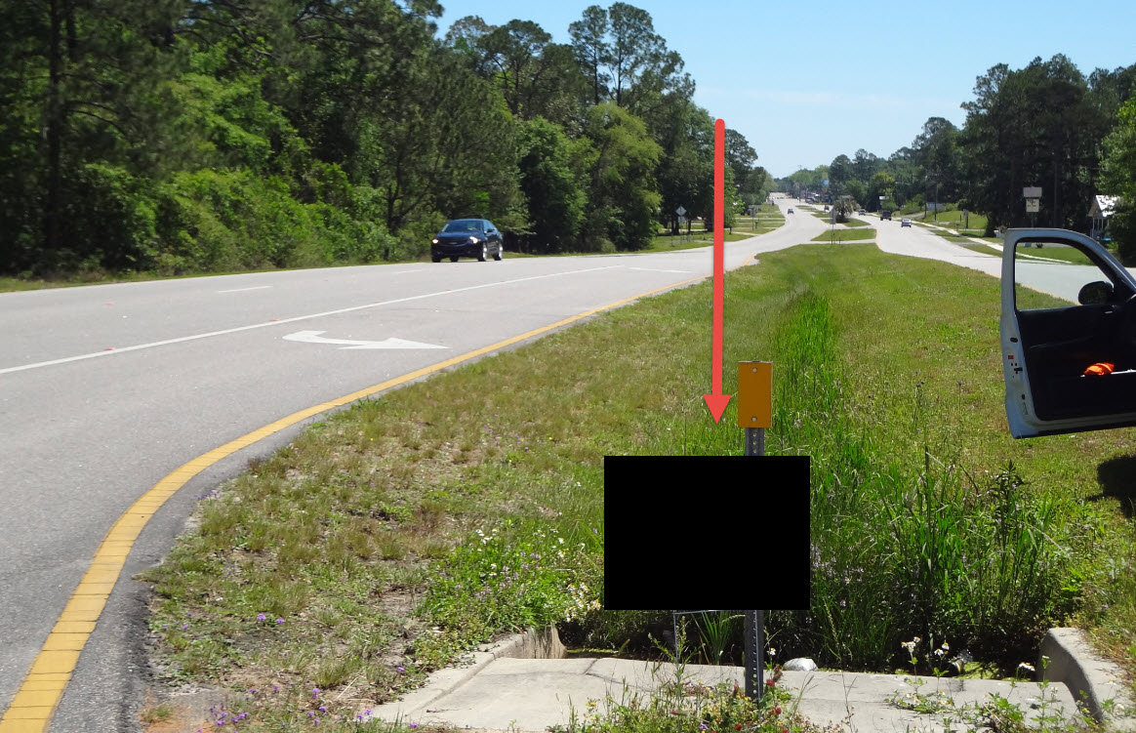

Slide 19
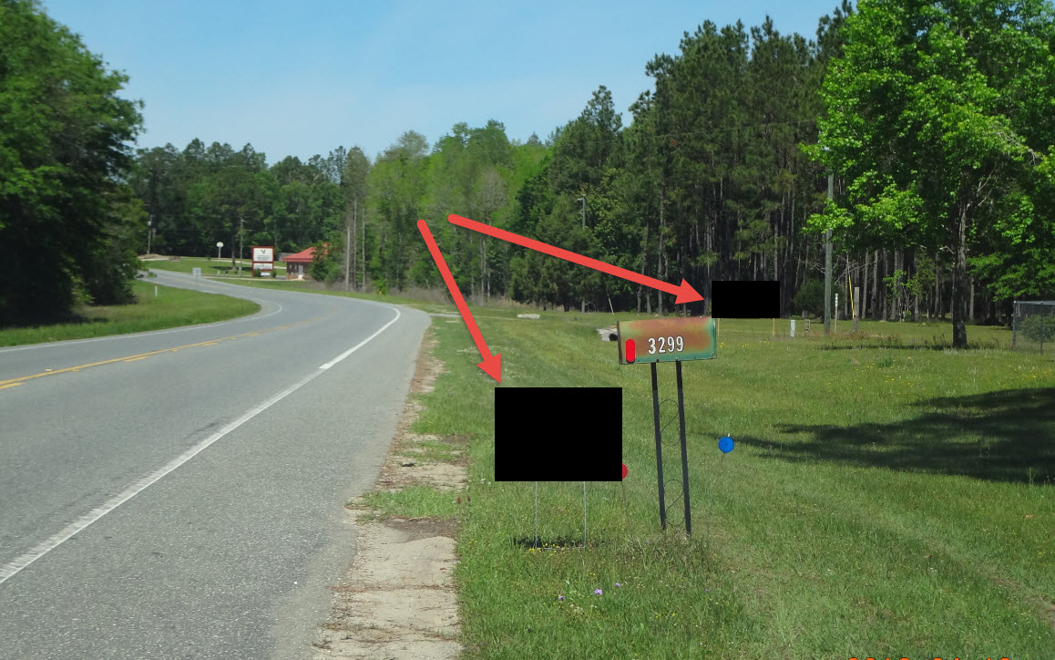

Slide 20
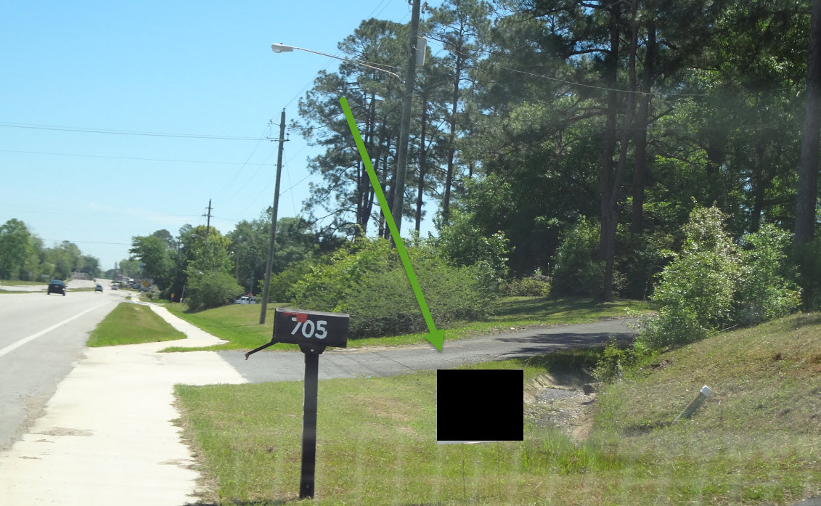

Slide 21
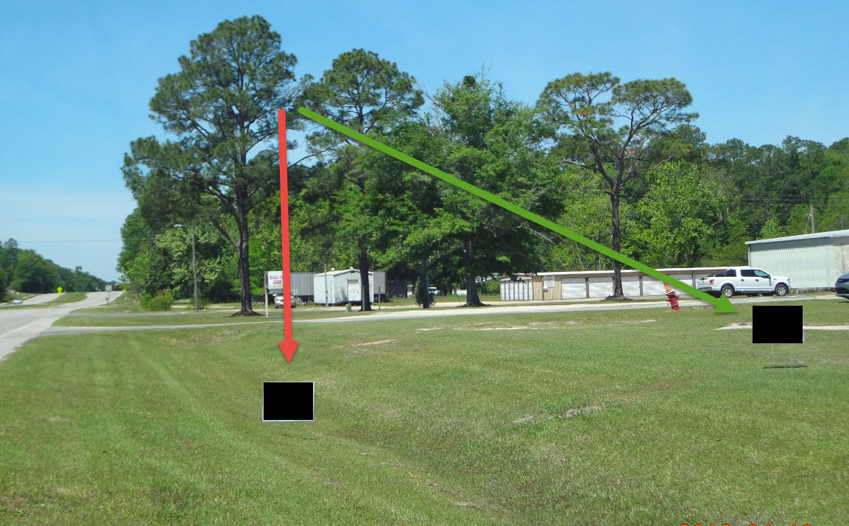

Slide 22
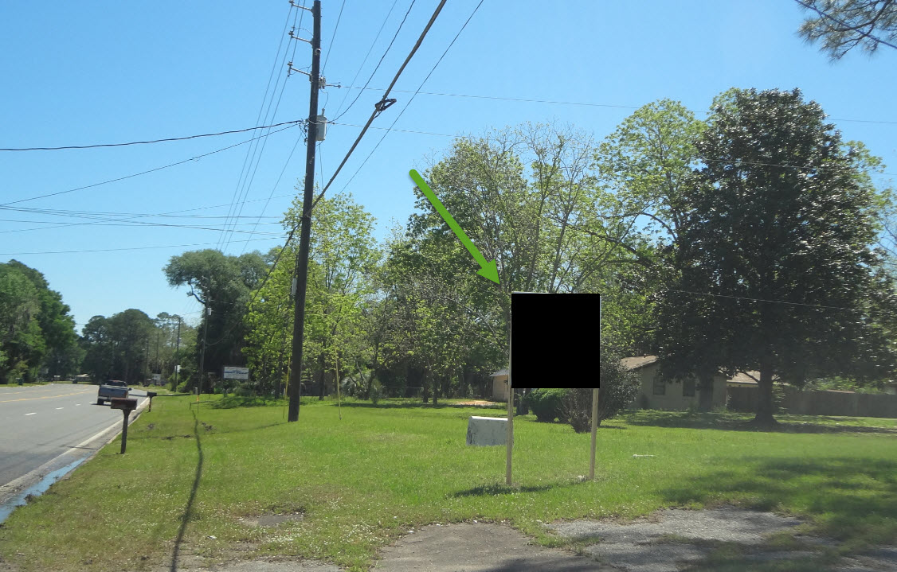

Slide 23
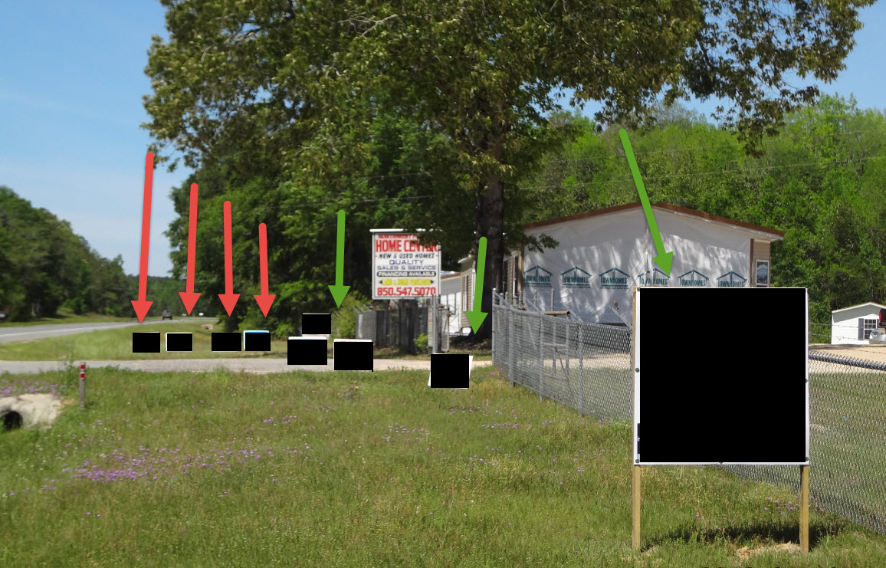

Slide 24
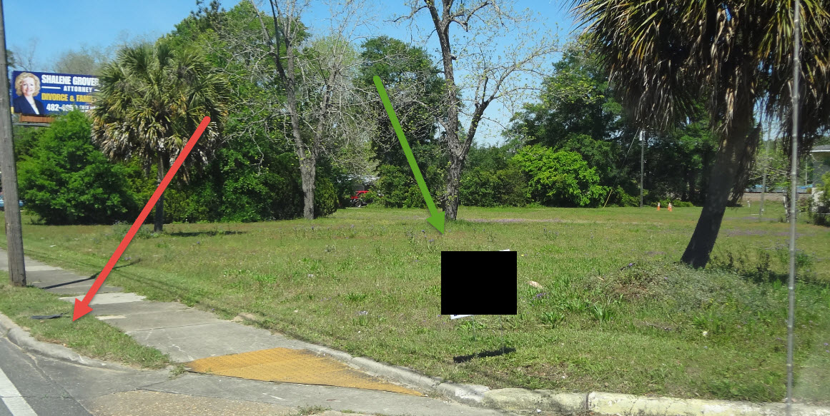

Slide 25
The End ☺
THANK YOU FOR YOUR CO-OPERATION AND GOOD LUCK !!

